Slide 1
3D Clipping

Slide 2
3D Viewing Pipeline
Primitives
Object space
Modeling Transformation
World space
Viewing Transformation
Camera space
Hidden Surface Removal
Lighting & Shading
3D-Clipping
Projection
Normalized view space
Scan conversion, Hiding
Image space, Device coordinates
Image

Slide 3
Contents
Introduction
Clipping Volume
Clipping Strategies
Clipping Algorithm

Slide 4
3D Clipping
Just like the case in two dimensions, clipping removes objects that will not be visible from the scene
The point of this is to remove computational effort
3-D clipping is achieved in two basic steps
Discard objects that can’t be viewed
i.e. objects that are behind the camera, outside the field of view, or too far away
Clip objects that intersect with any clipping plane

Slide 5
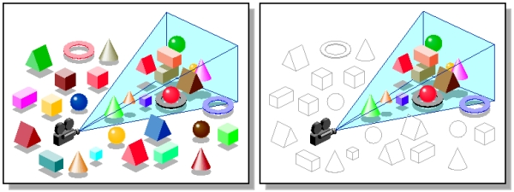
3D Clipping
Discarding objects that cannot possibly be seen involves comparing an objects bounding box/sphere against the dimensions of the view volume
Can be done before or after projection

Slide 6
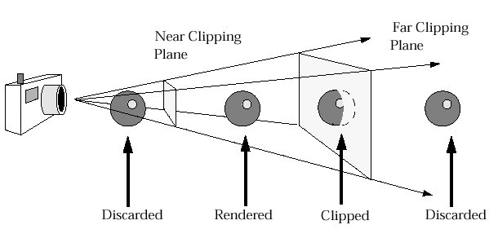
3D Clipping
Objects that are partially within the viewing volume need to be clipped – just like the 2D case

Slide 7
Contents
Introduction
Clipping Volume
Clipping Strategies
Clipping Algorithm

Slide 8
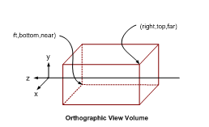
The Clipping Volume
In case of Parallel projections the infinite Parallelepiped is bounded by Near/front/hither and far/back/yon planes for clipping.

Slide 9
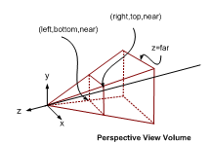
The Clipping Volume
In case of Perspective projections the semi Infinite Pyramid is also bounded by Near/front/hither and far/back/yon planes for clipping

Slide 10
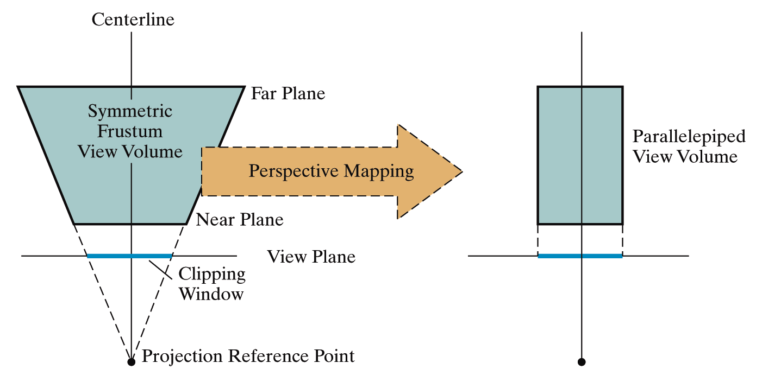
The Clipping Volume
After the perspective transformation is complete the frustum shaped viewing volume has been converted to a parallelepiped - remember we preserved all z coordinate depth information

Slide 11
Contents
Introduction
Clipping Volume
Clipping Strategies
Clipping Algorithm

Slide 12
Clipping Strategies
Because of the extraordinary computational effort required, two types of clipping strategies are followed:
Direct Clipping: The clipping is done directly against the view volume.
Canonical Clipping: Normalization transformations are applied which transform the original view volume into normalized (canonical) view volume. Clipping is then performed against canonical view volume.

Slide 13
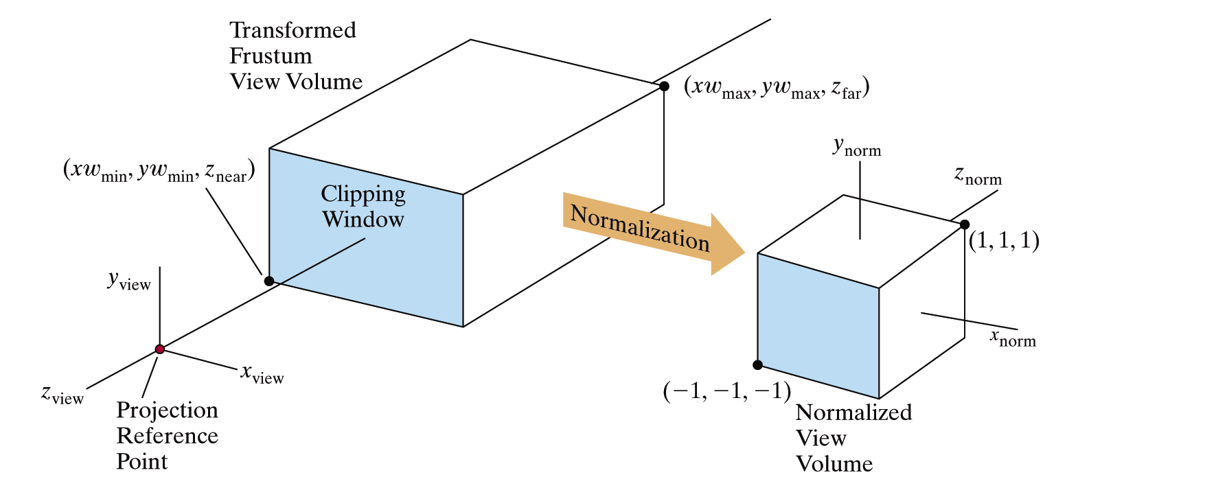
Clipping Strategies
The canonical view volume for parallel projection is the unit cube whose faces are defined by planes
x = 0 ; x = 1 y = 0; y = 1 z = 0; z = 1

Slide 14
Clipping Strategies
The canonical view volume for perspective projection is the truncated normalized pyramid whose faces are defined by planes
x = z ; x = -z y = z; y = -z z = z_{f}; z = 1
y
y
clipped line
x
clipped line
x
1
1
near
far
z
z
0
1
image plane
near
far

Slide 15
Clipping Strategies
We perform clipping after the projection transformation and normalizations are complete.
So, we have the following:
We apply all clipping to these homogeneous coordinates

Slide 16
Clipping Strategies
The basis of canonical clipping is the fact that intersection of line segments with the faces of canonical view volume require minimal calculations.
For perspective views, additional clipping may be required to avoid perspective anomalies produced by the projecting objects that are behind view point.

Slide 17
Contents
Introduction
Clipping Volume
Clipping Strategies
Clipping Algorithm

Slide 18
Clipping Algorithms
3D clipping algorithms are direct adaptation of 2D clipping algorithms with following modifications:
For Cohen Sutherland: Assignment of out codes
For Liang-Barsky: Introduction of new equations
For Sutherland Hodgeman: Inside/Out side Test
In general: Finding the intersection of Line with plane.

Slide 19
3D Cohen-Sutherland Line Clipping
Similar to the case in two dimensions, we divide the world into regions
This time we use a 6-bit region code to give us 27 different region codes
The bits in these regions codes are as follows:
bit 1 Above | bit 2 Below | bit 3 Right | bit 4 Left | bit 5 Behind | bit 6 Front

Slide 20
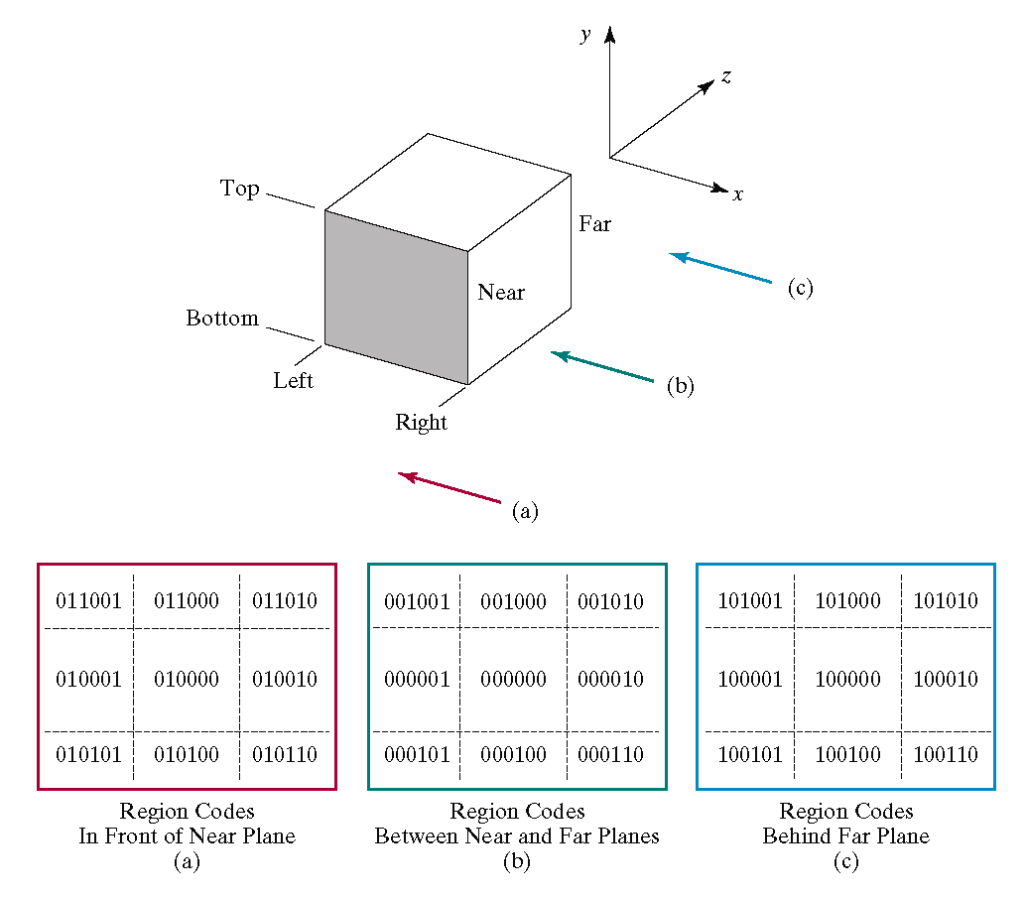
3D Cohen-Sutherland Line Clipping

Slide 21
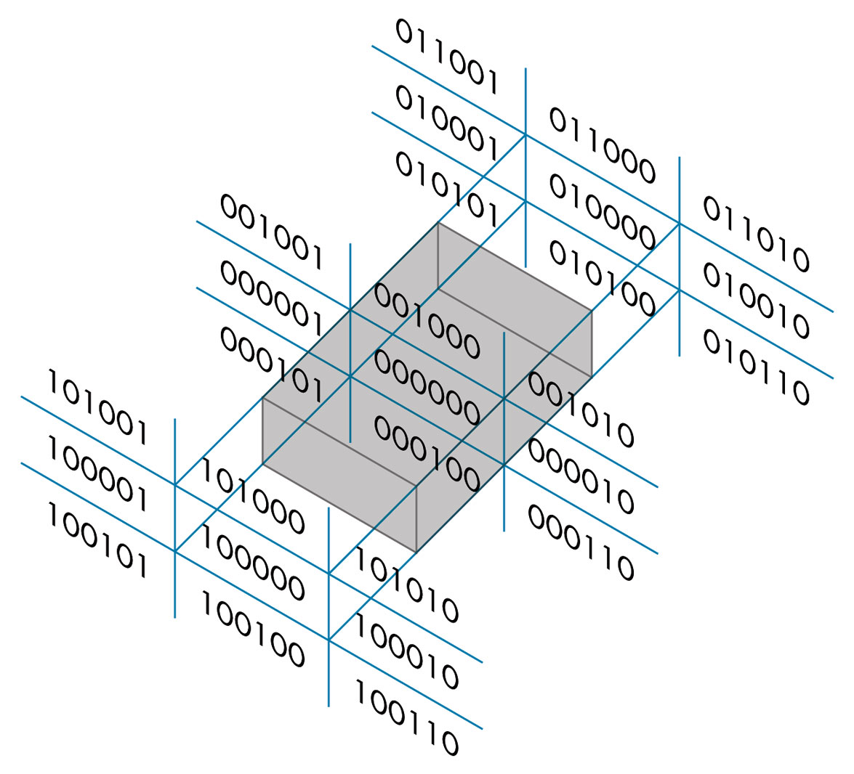
3D Cohen-Sutherland Line Clipping
Now we use a 6 bit out code to handle the near and far plane.
The testing strategy is virtually identical to the 2D case.

Slide 22
3D Cohen-Sutherland Line Clipping
CASE – I Assigning region codes to endpoints for Canonical Parallel View Volume defined by:
x = 0 , x = 1; y = 0, y = 1; z = 0, z = 1
The bit codes can be set to true(1) or false(0) for depending on the test for these equations as follows:
Bit 1 ≡ endpoint is Above view volume = sign (y-1)
Bit 2 ≡ endpoint is Below view volume = sign (-y)
Bit 3 ≡ endpoint is Right view volume = sign (x-1)
Bit 4 ≡ endpoint is Left view volume = sign (-x)
Bit 5 ≡ endpoint is Behind view volume = sign (z-1)
Bit 6 ≡ endpoint is Front view volume = sign (-z)

Slide 23
3D Cohen-Sutherland Line Clipping
CASE – II Assigning region codes to endpoints for Canonical Perspective View Volume defined by:
x = -z , x = z; y = -z, y = z; z = z_{f} , z = 1
The bit codes can be set to true(1) or false(0) for depending on the test for these equations as follows:
Bit 1 ≡ endpoint is Above view volume = sign (y-z)
Bit 2 ≡ endpoint is Below view volume = sign (-z-y)
Bit 3 ≡ endpoint is Right view volume = sign (x-z)
Bit 4 ≡ endpoint is Left view volume = sign (-z-x)
Bit 5 ≡ endpoint is Behind view volume = sign (z-1)
Bit 6 ≡ endpoint is Front view volume = sign (z_{f}-z)

Slide 24
3D Cohen-Sutherland Line Clipping
To clip lines we first label all end points with the appropriate region codes.
Classify the category of the Line segment as follows
Visible: if both end points are 000000
Invisible: if the bitwise logical AND is not 000000
Clipping Candidate: if the bitwise logical AND is 000000
We can trivially accept all lines with both end-points in the [000000] region.
We can trivially reject all lines whose end points share a common bit in any position.

Slide 25
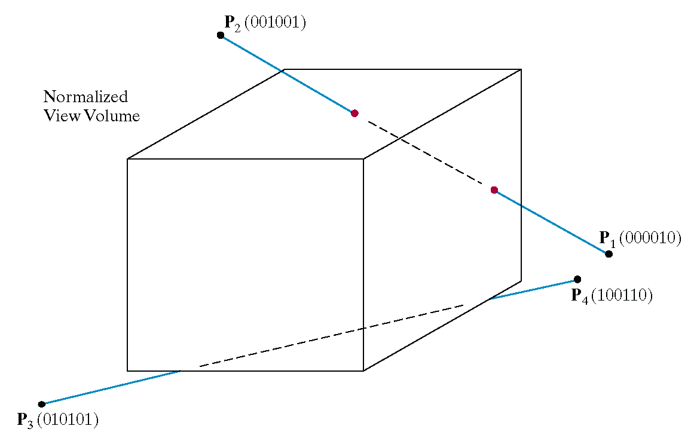
3D Cohen-Sutherland Line Clipping

Slide 26
3D Cohen-Sutherland Line Clipping
For clipping equations for three dimensional line segments are given in their parametric form.
For a line segment with end points P₁(x1_{h}, y1_{h}, z1_{h}, h1) and P₂(x2_{h}, y2_{h}, z2_{h}, h2) the parametric equation describing any point on the line is:
From this parametric equation of a line we can generate the equations for the homogeneous coordinates:

Slide 27

3D Cohen-Sutherland Line Clipping
Consider the line P₁[000010] to P₂[001001]
Because the lines have different values in bit 2 we know the line crosses the right boundary

Slide 28
3D Cohen-Sutherland Line Clipping
Since the right boundary is at x = 1 we now know the following holds:
which we can solve for u as follows:
using this value for u we can then solve for y_{p} and z_{p} similarly
Then simply continue as per the two dimensional line clipping algorithm

Slide 29
Cyrus Beck Line Clipping algorithm
Cohen Sutherland line clipping algorithm work on a rectangular box, but if we want to apply clipping algorithm for non- rectangular box then we use Cyrus back line clipping algorithm.
Cyrus Beck is a line clipping algorithm that is made for convex polygons.
It allows line clipping for non-rectangular windows

Slide 30
Cyrus Beck Line Clipping algorithm
This algorithm uses one parametric equation and by using this equation we find the intersecting point of the line with the boundary of the clipping window.
Parametric equation: let us consider two line endpoints P0, P1, then the parametric equation will be:
P(t)= P0+ t*(P1-P0)
Where
P0 is the starting point of the line.
P1 is the ending point of the line.
t is the parameter that varies between 0 and 1 to represent different points on the line.
t = 0 represents the point P0.
t = 1 represents the point P1.

Slide 31
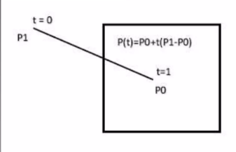
Cyrus Beck Line Clipping algorithm

Slide 32
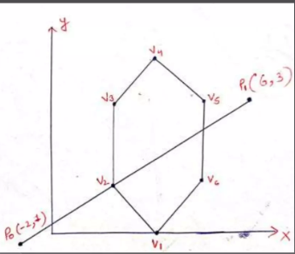
In this figure PO and P1 is a point of line.
We have to find out the only visible portion of the line and exterior portion of the line will be discarded.
For example, if we draw a line P0 to P1 and starting time for P0 is suppose t=0 and time of endpoint P1 is t=1.
In figure the initial value of PO=(-2,1) and P1=(6,3)So this algorithm work on the find out the point which will not be discarded and what was the time of that point.

Slide 33
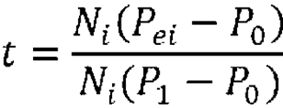
Cyrus Beck Line Clipping algorithm
After calculating the time of both point, we apply both values in the below formula and calculate the point value means this time value will help to find out the value of P’0, P’1
Here:-
Ni, N is a normal vector and i= edge no.
Pei = point of edge

Slide 34
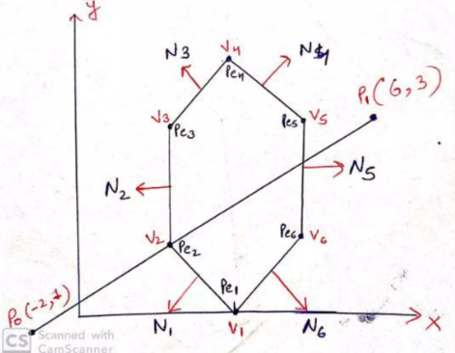
Steps of the Algorithm
Step 1- Firstly, we find the exterior point on the edge and give a name which is represent in a general way n(normal vector) which is an edge number
Figure:

Slide 35
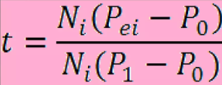

Steps of the Algorithm
Step 2- Now take a point on every edge or a vertex which is represented by Pe1 ...... Pei (point at edge)
Step 3- After calculating Ni or Pei then by using both value we can calculate the time for every edge of the polygon. For doing things we use this formula
Step 4- After calculating time for all edge then by using PO and P1 and use this time below formula and find out the value of Peo and P1

